Slide 1
Elastic Compute Cloud & EBS
AWS Essentials
SoftUni Team
Technical Trainers
Software University
https://softuni.org

Slide 2
Table of Contents
Compute 101
EC2 Overview
EC2 Hands-On

Slide 3
Have a Question?
sli.do
# AWS-essentials

Slide 4

Elastic Compute Cloud

Slide 5



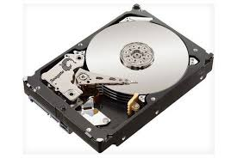
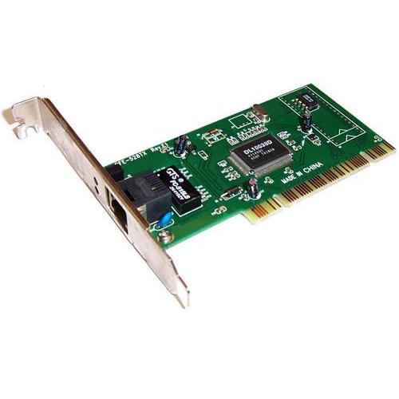

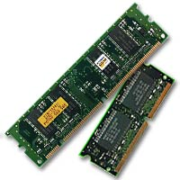
Compute 101
Operating System
CPU
Hard Drive
Network Card
Firewall
RAM

Slide 6
What is EC2?
AWS Definition:
Amazon EC2 provides scalable computing capacity. Using Amazon EC2 eliminates your need to invest in hardware upfront, so you can develop and deploy applications faster.
You can use Amazon EC2 to launch as many or as few virtual servers as you need.

Slide 7
ЕC2 101
AMI
Instance Type
EBS
IP Address
Security Groups
RAM

Slide 8
EC2 Instance Purchasing Options (1)
On Demand
This option allows you to choose any instance type you like and provision/terminate it at any time.
This is the most expensive and the most flexible option
You are only charged when the instance is running.
Reserved
Allows you to purchase an instance for a set period of 1 or 3 years.
Significant price discount compared to on demand.
You own it for the reserved period, and you're responsible for the full price, regardless how often you use it.

Slide 9
EC2 Instance Purchasing Options (2)
Spot
Amazon EC2 Spot Instances let you take advantage of unused EC2 capacity in the AWS cloud. Spot Instances are available at up to a 90% discount compared to On-Demand prices. You can use Spot Instances for various stateless, fault-tolerant, or flexible applications.

Slide 10
EC2 Instance Types
General Purpose
Compute Optimized
Memory Optimized
Accelerated Computing
Storage Optimized
https://aws.amazon.com/ec2/instance-types/

Slide 11
AMI Options
Community AMIs
Free to use
AWS Marketplace AMIs
Pay to use
Usually comes pre-configured and with added software
My AMIs
AMIs you create yourself

Slide 12
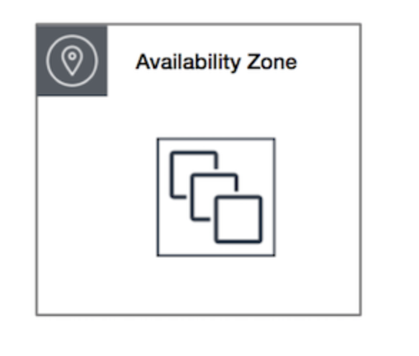
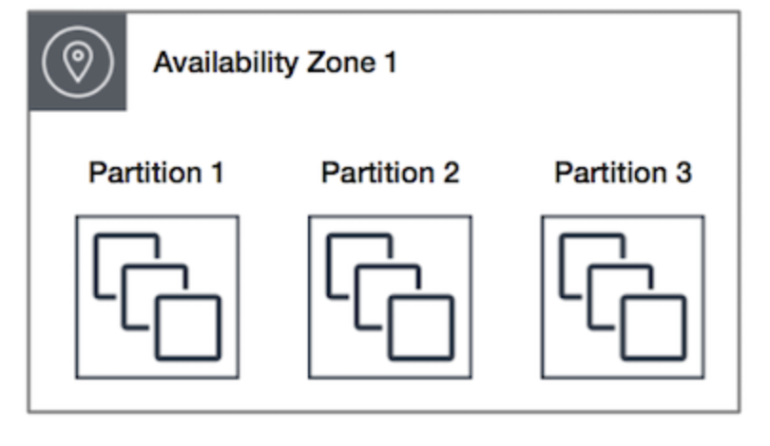
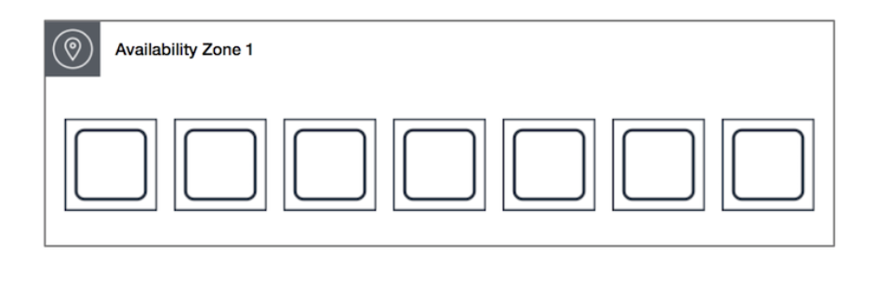
Placement Groups
Cluster
Packs instances close together inside an Availability Zone
Partition
This strategy is typically used by large distributed and replicated workloads, such as Hadoop, Cassandra, and Kafka.
Spread
Strictly places a small group of instances across distinct underlying hardware to reduce correlated failures.

Slide 13

Security Groups
Virtual Firewall that controls traffic for one or more instances.
When you launch an instance, you associate one or more security groups with the instance. You add rules to the security group that allow traffic to or from the associated instance.

Slide 14

ЕC2 Workshop

Slide 15
Workshop
Userdata script:
#!/bin/bash
sudo yum update -y
sudo yum install -y httpd24 php56 php56-mysqlnd
sudo service httpd start

Slide 16

Summary
…
…
…
Overview of IAM
IAM Groups, Users, Roles and Policies
IAM Hands-On
Compute 101
EC2 Overview
EC2 Hands-On

Slide 17
Questions?

Slide 18











SoftUni Diamond Partners

Slide 19



Educational Partners

Slide 20
Trainings @ Software University (SoftUni)
Software University – High-Quality Education, Profession and Job for Software Developers
softuni.bg, about.softuni.bg
Software University Foundation
softuni.foundation
Software University @ Facebook
facebook.com/SoftwareUniversity
Software University Forums
forum.softuni.bg

Slide 21

License
This course (slides, examples, demos, exercises, homework, documents, videos and other assets) is copyrighted content
Unauthorized copy, reproduction or use is illegal
© SoftUni – https://about.softuni.bg/
© Software University – https://softuni.bg

